Slide 1

Long Term Health Conditions – trend analysis
Australia 2021
By Minali, irina and Kirsty (Team 5)

Slide 2
Introduction
Chronic conditions are a focus of ongoing national surveillance through self-reported data collected by the Australian Bureau of Statistics during Census 2021 (National Health Survey, Census collections and Australian Institute of Health and Welfare expenditure data).
Chronic conditions are something which most of us have an experience of directly or through the observations of a close family member with a chronic condition.
Each group member supported an interest in understanding what the impact of a chronic condition is on other aspects of a person’s life such as employment, independence and income and how this impact varies across age and sex.
Notes:
Exploratory data analysis occurs throughout the Healthcare industry at a local and systemic level from population level, burden of disease, measures of mortality and morbidity and multi-morbidity. Exploration is important as it informs healthcare spending at different levels and spending modalities and expenditure in areas such as prevention initiative, treatment services, research and capital spending.

Slide 3
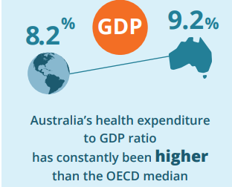
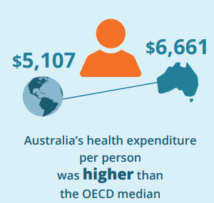

Health IN Australia
Upcoming Deposits
$202.5 b
$134 b
2015-16
Musculoskeletal
10.7%
Attributed to specific disease groups 2018-19
x
Cardiovascular disease
Health Expenditure 2019-20
8.9%
10.2% GDP
Injuries
7.6%
Mental and substance
use disorders
7.6%
Notes:
Research on topic area
Kaggle and other data options – high level overview
Data available from AIHW

Slide 4

DEFINE AND preparE
Chronic diseases are long-lasting conditions (+ 6 months) with persistent effects. Many people with chronic conditions do not have a single, predominant condition, but rather they experience multimorbidity – the presence of 2 or more chronic conditions in a person at the same time
Limitation
Initial research based on data summaries from 2015-16, 2018-19 and 2019-20, the analysis undertaken was for Census 2021 only.
Notes:
-Irina-
Terminology/definitions
Chronic diseases are long-lasting conditions with persistent effects. Many people with chronic conditions do not have a single, predominant condition, but rather they experience multimorbidity – the presence of 2 or more chronic conditions in a person at the same time. (https://www.aihw.gov.au)
The Australian government identifies the duration of chronic diseases is ‘one that has been, or is likely to be, present for six months or more’. (https://www1.racgp.org.au)
The Australian Institute of Health and Welfare (AIHW) identifies 10 major chronic condition groups: arthritis, asthma, back pain, cancer, cardiovascular disease, chronic obstructive pulmonary disease, diabetes, chronic kidney disease, mental health conditions, and osteoporosis. These chronic conditions were selected for reporting because they are common and pose significant health problems. (https://www.aihw.gov.au)
Limitations
Initial research based on data summaries from 2015-16, 2018-19 and 2019-20, the analysis undertaken was for Census 2021 only.
Analysis and comparisons between countries.

Slide 5
Data sourcing, preparation and cleansing
Quality
Remove duplicate or irrelevant observations
Structural errors
Format types, naming conventions, typos
Values
Missing data, n/a and null values
Notes:
What is data cleaning?
Data cleaning is the process of fixing or removing incorrect, corrupted, incorrectly formatted, duplicate, or incomplete data within a dataset. When combining multiple data sources, there are many opportunities for data to be duplicated or mis-labeled. If data is incorrect, outcomes and algorithms are unreliable, even though they may look correct. There is no one absolute way to prescribe the exact steps in the data cleaning process because the processes will vary from dataset to dataset. But it is crucial to establish a template for your data cleaning process so you know you are doing it the right way every time.
What is the difference between data cleaning and data transformation?
Data cleaning is the process that removes data that does not belong in your dataset. Data transformation is the process of converting data from one format or structure into another. Transformation processes can also be referred to as data wrangling, or data munging, transforming and mapping data from one "raw" data form into another format for warehousing and analyzing. This article focuses on the processes of cleaning that data.
Validate
At the end of the data cleaning process, you should be able to answer these questions as a part of basic validation:
Does the data make sense?
Does the data follow the appropriate rules for its field?
Does it prove or disprove your working theory, or bring any insight to light?
Can you find trends in the data to help you form your next theory?
If not, is that because of a data quality issue?

Slide 6

Data exploration

Slide 7
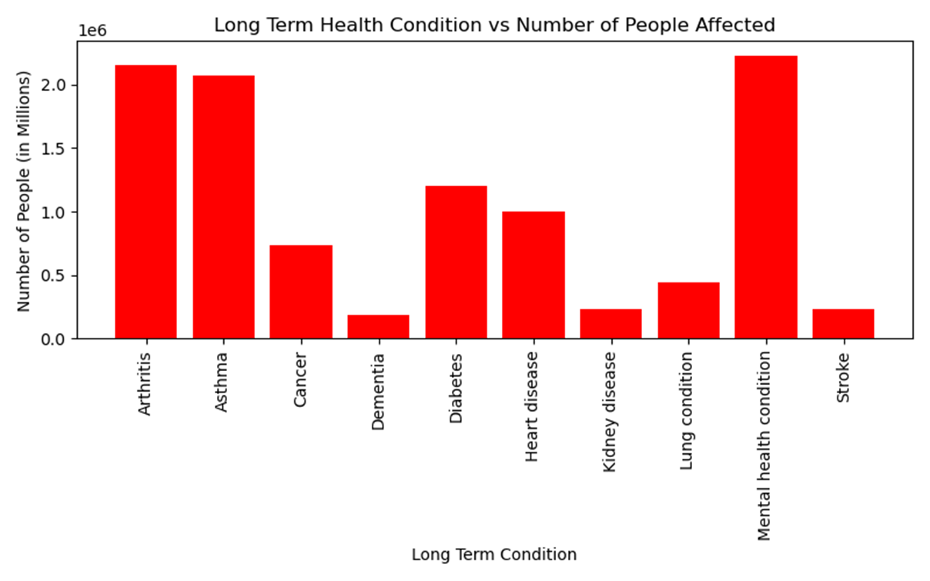
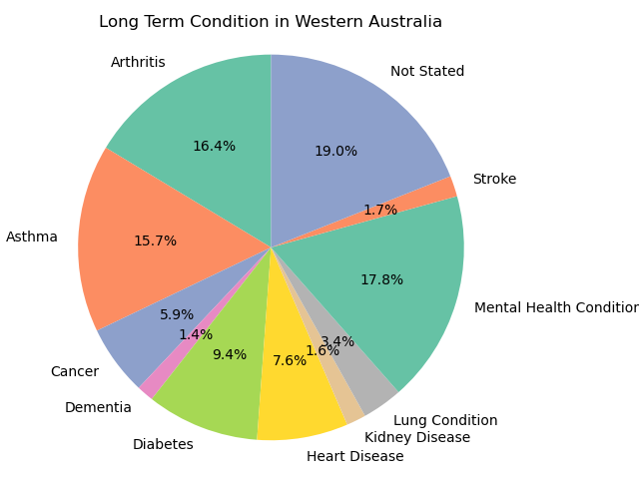
Long term condition proportions
2021 data:
Mental Health Condition – shift from initial research data
Arthritis
Asthma
MINALI
Notes:
Figure 1 (left hand-side) provides proportions for Australia (aggregate – age and gender)– MH condition, Arthritis, asthma – (highest down)
Figure 2 (right hand-side) proportions for WA by condition
According to the pie chart, 17.8% of Western Australia's population in 2021 suffered from mental diseases or chronic mental health conditions. Diabetes, stroke, and kidney disease were on the bottom of the list with less than 2% of the population affected. Meanwhile, asthma and authorities had a prevalence of over 15%. However, when compared to other Australian states, Western Australia ranked fourth in the total number of people with chronic illnesses, with NSW, Victoria, and Queensland leading the pack.

Slide 8


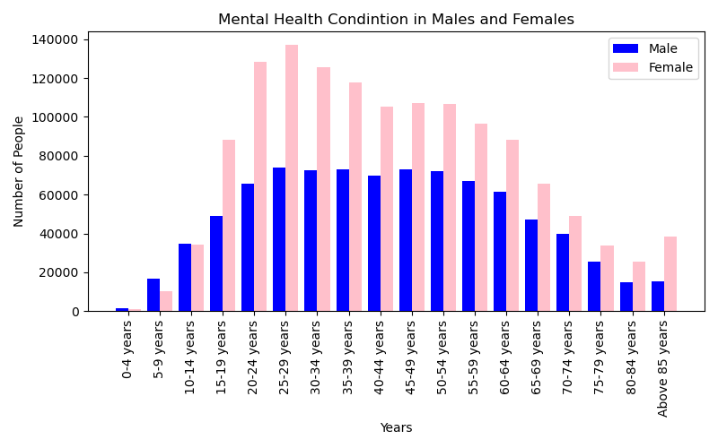
Females proportionately higher than males
25-29; 20-24 highest age proportions for both females and males
Normal curve distribution
MINALI
Notes:
This is for Australia by sex

Slide 9
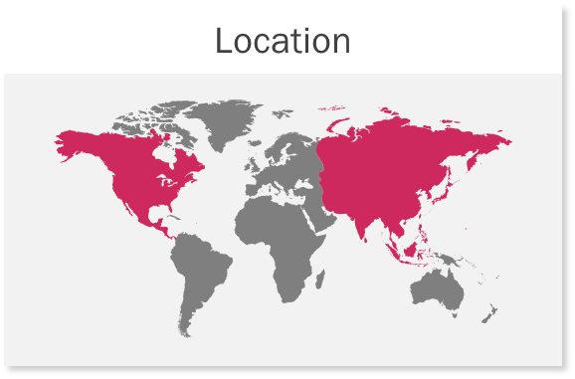
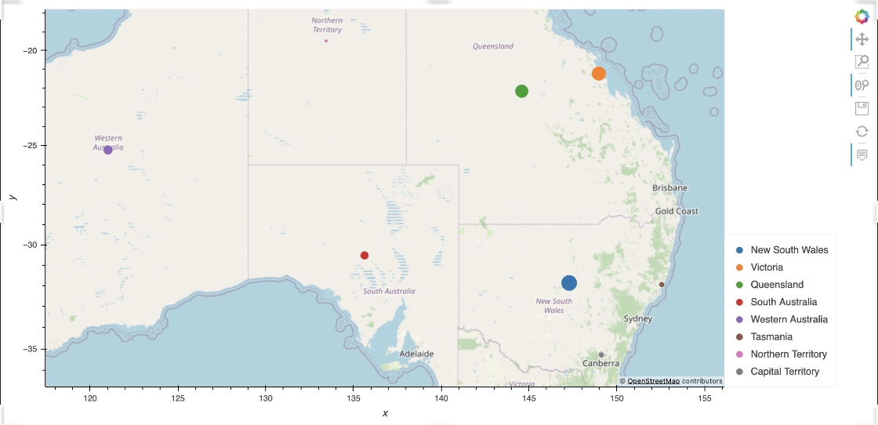
Geo-map
Minali
Notes:
State total – comparison of state vs state – larger the circle, higher the total affected with a chronic illness

Slide 10
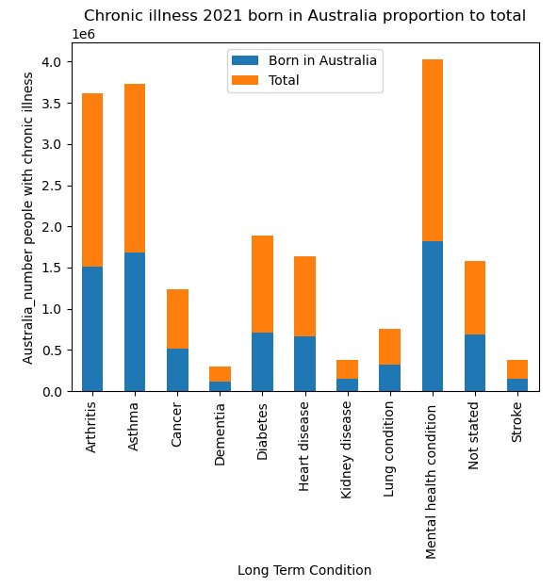
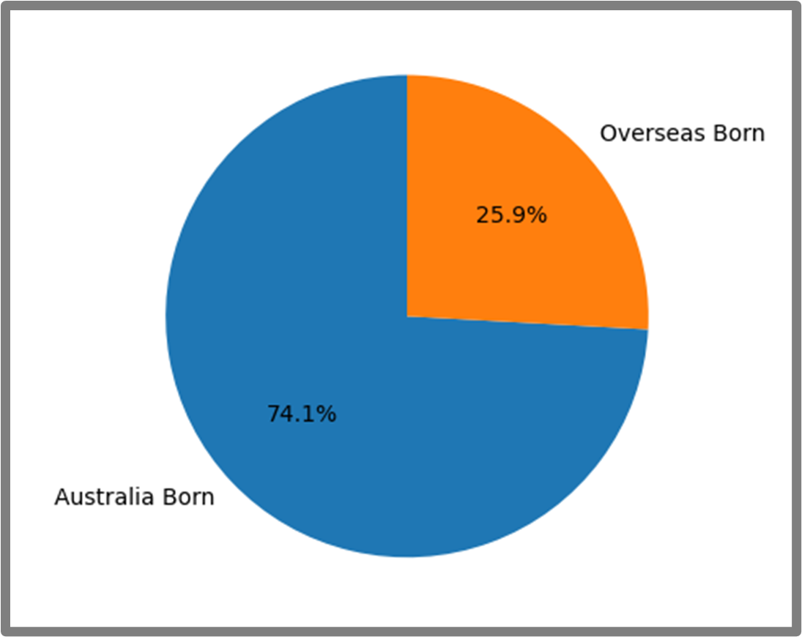
Continent of birth
Highest ranked conditions have relatively even proportions with country of birth Australian born vs Overseas born
Irina
Notes:
The bar chart illustrates the proportion of people in Australia with chronic diseases who were born in Australia.
Finding: Since the majority of chronic conditions are found among the local population, the government needs to explore new ways to prevent chronic illnesses, especially mental health conditions, arthritis, asthma, diabetes, and heart diseases, particularly among females.

Slide 11
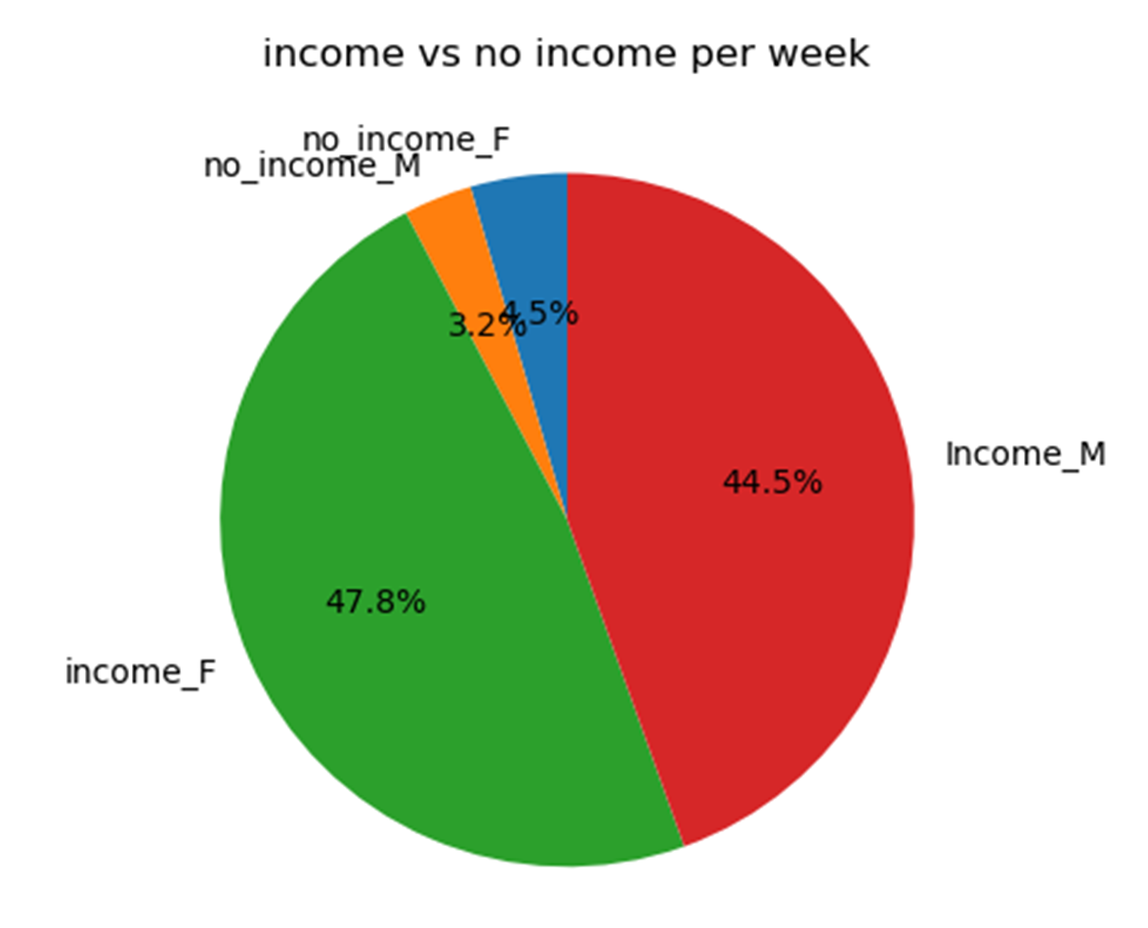
InCOME
Irina
Notes:
Exploratory data analysis occurs throughout the Healthcare industry at a local and systemic level from population level, burden of disease, measures of mortality and morbidity and multi-morbidity. Exploration is important as it informs healthcare spending at different levels and spending modalities and expenditure in areas such as prevention initiative, treatment services, research and capital spending.

Slide 12
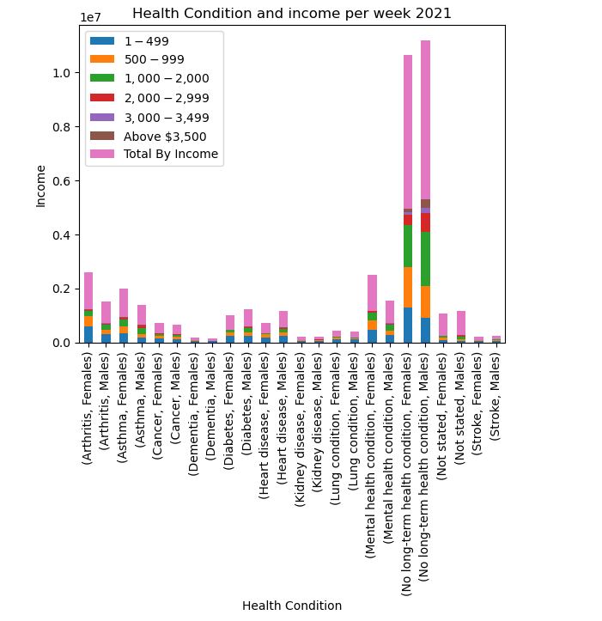
Income by sex
Irina
Notes:
The bar chart provides a breakdown of the number of people in Australia with various health conditions, categorized by sex and income level. The income levels are divided into several ranges, including no income, $1-499, $500-999, $1,000-1,999, $2,000-2,999, $3,000-3,499, above $3,500, and not stated. For each health condition and sex, the number of people with that condition is broken down by income level, with the "Total By Income" column showing the total number of people with the condition in each income level.
For instance, the chart reveals that 90,627 females with arthritis reported no income, while 38,530 females with arthritis reported an income of $1-149. Similarly, the data shows that 48,340 females with arthritis reported an income of above $3,500, with a total number of females with arthritis in all income levels reaching 1,358,135. Overall, the majority of people with chronic illnesses had an income of no more than $500 per week, highlighting the significant impact of chronic illnesses on a person's ability to earn more and participate in the workforce.

Slide 13
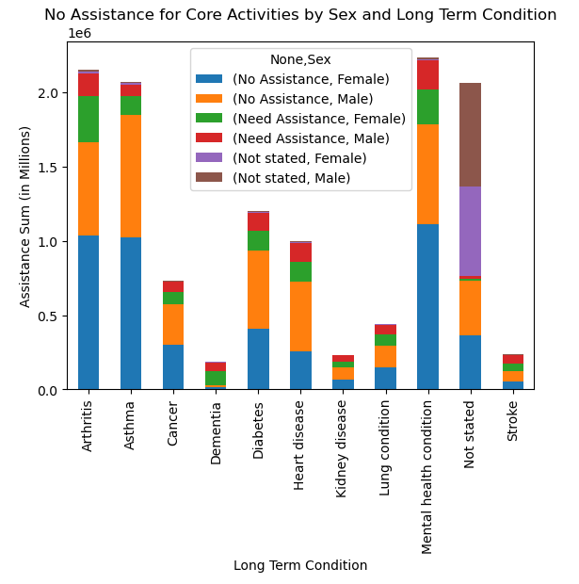
Assistance type
Activities of daily living (ADLs)
Assistance, No assistance, Not stated
Data exploration - Females / Arthritis
Kirsty
Notes:
Stacked bar graph grouping of long term conditions and removal of irrelevant LTC types for the visualisation (No long term condition, not stated was left in as this was seen as relevant). This was done so that the visualisation focussed on the question being asked – what conditions by sex and condition type require what type of assistance by type
Types are assistance, no assistance or not stated.
Aggregate data generated,
Table printed then visualisation
Male: Compare orange, red, brown
Female: blue, green, purple
Furthermore, the data revealed that females required more assistance with daily life activities than males. The largest number of females who needed help were women with arthritis.

Slide 14
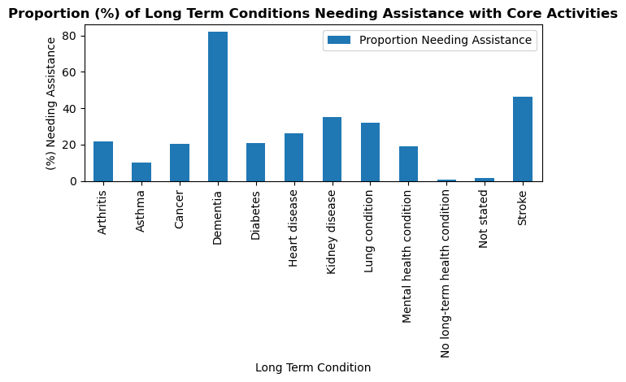
Assistance type
Kirsty
Notes:
Original dataframe had assistance types by sex and assistance type
Data exploration to look at quotient of those who have stated assistance needed out of total
Dementia followed by stroke as the highest proportion of total
Further exploration could be undertaken to look at age and comparisons to population/other data

Slide 15
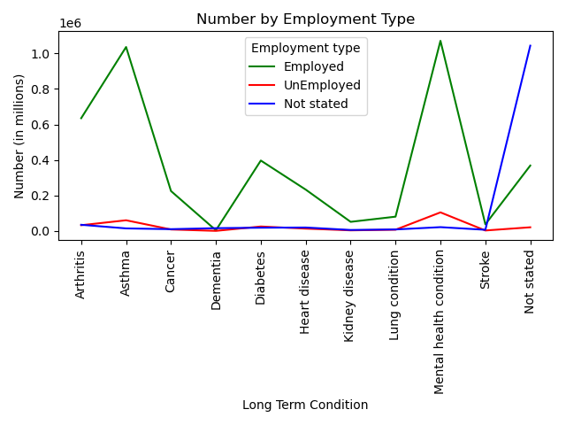
Labour force
Employment types by long term conditions
Age factor
Further insight age and ADL assistance
Kirsty
Notes:
Data patterns

Slide 16

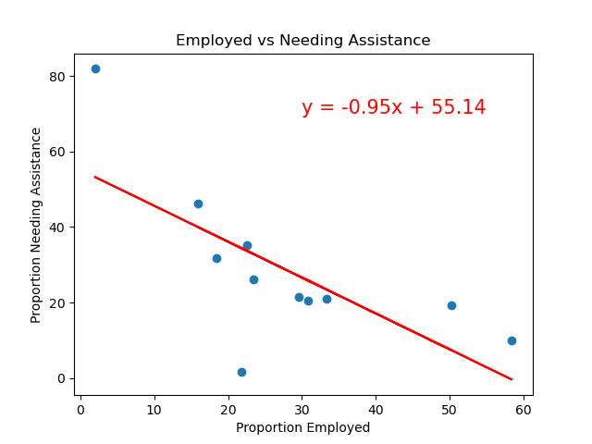
Slide 6
Correlation
Negative relationship between those who are employed against those who need assistance
When one goes up the other goes down
Kirsty
Notes:
Dataframes created – calculating proportions for each and then undertaking linear regression process using scipy
Data patterns, initial understanding – expectation that those who need assistance are less likely to work, further hypothesis testing could be undertaken to test this.

Slide 17
Thank you

